Slide 1
Deployment – 1 (strategies and horizontal consistency)
Len Bass
Notes:
This is the slide title. The title of the lecture topic goes in:
<Lecture Title Here>
The lecturer should put their name in:
<Presenter’s Name Here>

Slide 2
Situation
Your application is executing
  Multiple independent deployment units
  Some of these deployment units may have multiple instances serving requests
You have a new version of one of the deployment units to be placed into production
An image of the new version is on the staging server or in a container repository
copyright 2015 Len Bass

Slide 3

Deploying a new version of an application
Multiple instances of a service are executing
Red is service being replaced with new version
Blue are clients
Green are dependent services
V_{B}
V_{B}
V_{A}
V_{B}
Staging/container repository

Slide 4
Deployment goal and constraints
Goal of a deployment is to move from current state (N instances of version A of a service) to a new state (N instances of version B of a service)
Constraints:
  Any development team can deploy their service at any time. I.e. New version of a service can be deployed either before or after a new version of a client. (no synchronization among development teams)
  It takes time to replace one instance of version A with an instance of version B (order of minutes)
  Service to clients must be maintained while the new version is being deployed.

Slide 5
Deployment strategies
Two basic all of nothing strategies
  Red/Black – leave N instances with version A as they are, allocate and provision N instances with version B and then switch to version B and release instances with version A.
  Rolling Upgrade – allocate one instance, provision it with version B, release one version A instance. Repeat N times.
Partial strategies are canary testing and A/B testing.

Slide 6

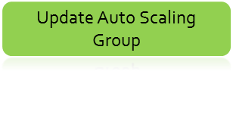


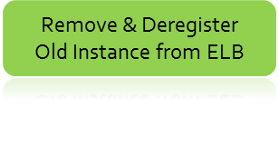
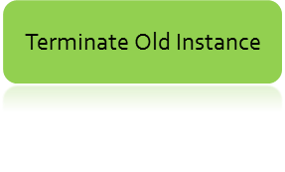
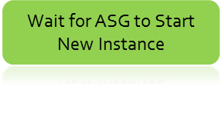
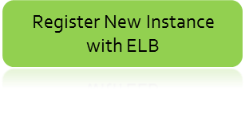

Trade offs – Red/Black and Rolling Upgrade
Red/Black
  Only one version available to the client at any particular time.
  Requires 2N instances (additional costs)
Rolling Upgrade
  Multiple versions are available for service at the same time
  Requires N+1 instances.
Rolling upgrade is widely used.
Rolling
Upgrade in EC2

Slide 7
Problems to be dealt with
Horizontal consistency
  Multiple versions of a single service may be executing simultaneously
  Some instances may have version A and others version B of the service
Vertical consistency
  Different services in a request chain may or may not have been updated
Data consistency
  The integrity of the data base must be maintained
copyright 2015 Len Bass

Slide 8
Maintaining horizontal consistency with Red/Black deployment
Recall how service is found
  DNS server
  Load balancer
Allocate distinct load balancers for instances of version B
New services register with newly allocated load balancers
When N instances of version B loaded, change DNS server to point to new load balancers.
New requests will go to version B
Drain version A servers and delete them

Slide 9
Horizontal consistency problem with Rolling Upgrade
The red service is being replaced
  At any point in time some instances will be version A and others will be version B
Error sequence
  Client accesses version B
  Gets state returned.
  This same client now passes returned state during next call to the service
  New call is sent to an instance of version A
  Version A does not understand state
  Error
V_{B}
V_{B}
V_{A}
V_{B}
copyright 2015 Len Bass

Slide 10
Maintaining horizontal consistency with rolling upgrade
Key idea – differentiate between installing a new version and activating a new version
Involves “feature toggles”
Sequence
  Develop version B with new code under control of feature toggle
  Install each instance of version B with the new code toggled off.
  When all of the instances of version A have been replaced with instances of version B, activate new code through toggling the feature.

Slide 11
Issues
Do you remember feature toggles?
How do I activate all relevant instances at once?

Slide 12
Feature toggle
Place feature dependent new code inside of an “if” statement where the code is executed if an external variable is true. Removed code would be the “else” portion.
Used to allow developers to check in uncompleted code. Uncompleted code is toggled off.
During deployment, until new code is activated, it will not be executed.
Removing feature toggles when a new feature has been committed is important.

Slide 13
Feature toggle manager
There will be many different feature toggles
  One for each feature
A feature toggle manager maintains a catalog of feature toggles
  Current toggles vs instance version id
  Current toggles vs module version
  Status of each toggle
  Activate/de-activate feature
  Remove toggle (will place removal on backlog of appropriate development team).
copyright 2015 Len Bass

Slide 14
Activating feature
The feature toggle manager changes the value of the feature toggle. Two possible techniques to get new value to instances.
  Push. Broadcasting the new value will instruct each instance to use new code. If a lag of several seconds between the first service to be toggled and the last can be tolerated, there is no problem. Otherwise synchronizing value across network must be done.
  Pull. Querying the manager by each instance to get latest value may cause performance problems.
A coordination mechanism such as Zookeeper or Consul could be used to implement both techniques.

Slide 15
Summary
Two basic deployment strategies – red/black and rolling upgrade
Maintaining horizontal consistency during rolling upgrade
  Install all instances before activating any new code
  Use feature toggles to activate new code
  Use feature toggle manager to determine when to activate new code
  Use coordination manager to coordinate activation with low overhead

